Slide 1
RPL:IPv6 Routing Protocol for Low Power and Lossy Networks

Slide 2
Outline
INTRODUCTION
TERMINOLOGY
RPL DESIGN OVERVIEW
UPWARD ROUTING
ROUTING LOOPS
RPL METRICS
DOWNWARD ROUTING
CONCLUSION
REFERENCE

Slide 3
INTRODUCTION
Over the last years WSNs have become a very important and challenging research field.
There are cases where a network can only achieve approximately the half of the throughput of the corresponding lossless network.
Lossy links effect the power consumption due to packet retransmissions and broadcasting.
Notes:
In recent years, WSN has become an important and challenging field of research.

Slide 4
INTRODUCTION(Cont.)
Such LLNs are additionally characterized by connections that are not restricted to two endpoints.
The Internet Engineering Task Force (IETF) ROLL Working Group designed a new routing protocol, called RPL.
The highest goal of RPL is to provide efficient routing paths for P2MP and MP2P traffic patters in LLNs.

Slide 5
TERMINOLOGY
DAG(Directed Acyclic Graph)
DAG root
DODAG(Destination-Oriented DAG)
DODAG root
Rank
OF(Objective Function)
RPL Instance
RPLInstanceID
Notes:
DAG: Directed Acyclic Graph.
A directed graph having the property that all edges are oriented in such a way that no cycles exist. All edges are contained in paths oriented toward and terminating at one or more root nodes.
DAG root
A DAG root is a node within the DAG that has no outgoing edge.
DODAG(Destination-Oriented DAG)
There is only one root DAG
DODAG root:
The above root
Rank:
This node relative to other nodes and the root of the gap, the value of the detailed method of calculation, the need to define through the OF
Objective Function (OF):
An OF defines how routing metrics, optimization objectives, and related functions are used to compute Rank.
Define the routing metric and whether the node is suitable for the selection of the evaluation method and the RANK calculation method
RPL Instance:
A collection of multiple DODAGs that share the same RPLInstanceID. One RPL node, at most one belonging to a DODAG in one RPLInstance
RPLInstanceID:
A RPLInstanceID is a unique identifier within a network.
DODAG shares the same OF with the other DODAGs of the same RPLInstanceID

Slide 6
TERMINOLOGY(Cont.)
DODAGID
Sub-DODAG
DIO(DODAG Information Object)
DAO(Destination Advertisement Object)
DIS(DODAG Information Solicitation)
Notes:
DODAGID
A DODAGID is the identifier of a DODAG root. The DODAGID is unique within the scope of a RPL Instance in the LLN. The tuple (RPLInstanceID, DODAGID) uniquely identifies a DODAG.
Usually the root ipv6 address
Sub-DODAG
The sub-DODAG of a node is the set of other nodes whose paths to the DODAG root pass through that node.
DIO

Slide 7
RPL DESIGN OVERVIEW
RPL is a distance vector routing protocol for LLNs that makes use of IPv6.
The protocol tries to avoid routing loops by computing a node’s position relative to other nodes with respect to the DODAG root.
The RPL specification defines four types of control messages for topology maintenance and information exchange.
Another important fact about the protocol’s design is the maintenance of the topology.

Slide 8
UPWARD ROUTING
Upward routing is a standard procedure which enables network devices to send data to a root.
In a typical WSN scenario, nodes periodically generate data packets which have to find their way through the network.
In this section:
DIO Message Structure
Construction Topologies
Notes:
Upward routing Is a standard handler that enables a network device to send data back to root
In a typical WSN environment, a node periodically generates data and needs to find a path in the network to pass the data back to the root
This section will refer to two parts, namely DIO message Structure, Construction Topologies

Slide 9
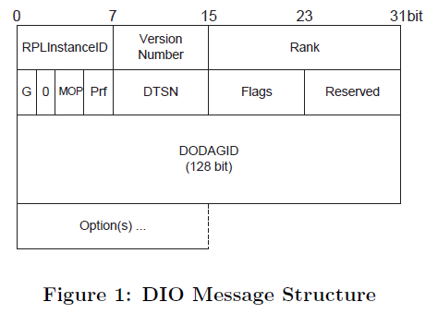
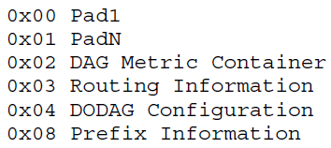
DIO Message Structure
DIO message is the main source of information which is needed during topology construction.
DIO Option
Notes:
DIO message Is the main source of information in the process of topology building.
The picture shows DIO Message Structure
The first field is RPL instance ID
RPLInstanceID: A RPLInstanceID is a unique identifier within a
network. DODAGs with the same RPLInstanceID share the same
Objective Function.
The second and third fields store the sender's DODAG Version (8bit u_int set by root) and Rank (16bit u_int for the rank of the node sending this DIO message)
Flag G is used to define whether DODAG is grounded, if it is a grounded, if it is 0 floating? DODAG can be divided into grounded or floating
DODAGs can be grounded or floating: the DODAG root advertises which is the case.
A grounded DODAG offers connectivity to hosts that are required for satisfying the application-defined goal.
A floating DODAG is not expected to satisfy the goal; in most cases, it only provides routes to nodes within the DODAG.
Floating DODAGs may be used, for example, to preserve interconnectivity during repair.
mode of operationMOP
Used to determine the downward routing related settings, and each join the DODAG node if you can meet this configuration, you can join the identity of the router, if not, you can only join the identity of the leaf.
The Prf (DAGPreference) is used to compare the best between the root nodes, 7 is the best; 0 the other hand. The initial value is 0
DTSN (Destination Advertisement Trigger Sequence Number): 8-bit unsigned int placed by the node sent to this DIO message

Slide 10
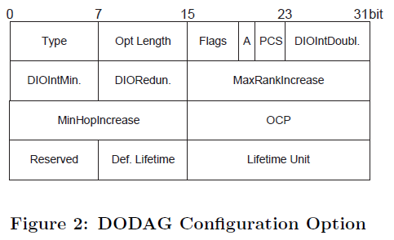
DODAG Configuration Option
A DIO message may be extended by the use of options.

Slide 11
Construction Topologies
In a RPL network, node have three type:
root node
routers
leaf
Step1. Construction topology starts at a root node begins to send DIO messages.
Step2. Each node that receives the message runs an algorithm to choose an appropriate parent.
The choice is based on the used metric and constraints defined by the OF.

Slide 12
Construction Topologies(Cont.)
Step3. Each of them computes its own Rank and in case a node is a router, it updates the Rank in the DIO message and sends it to all neighboring peers.
Step4. Repeat Step.2 and Step3. the process terminates when a DIO message hits a leaf or when no more nodes are left in range.
Three values have to be considered in order to uniquely identify a DODAG:
RPL Instance ID: identification of an independent set of DODAG.
DODAG ID: is a routable IPv6 address belonging to the root
DODAG version number: is incremented each time a DODAG reconstruction.

Slide 13

Construction Topologies(Cont.)
To achieve RPL dynamically adapts the sending rate of DIO, two values need to be used.
the minimum sending time interval, $T_{min}$
the maximum sending interval, $T_{max}$
Notes:
In order to achieve the RPL dynamic control DIO transmission green, two jobs were used
Minimum transmission time interval
Maximum transmission time interval
Each time the transmit timer expires, RPL doubles it to a maximum value Tmax.
Whenever RPL detects an event indicating that the topology needs to be maintained effectively, it sets the timer Tmin.

Slide 14
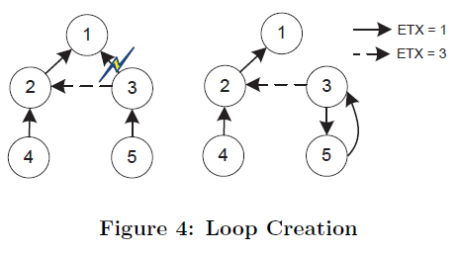
ROUTING LOOPS
The formation of routing loops is a common problem in all kinds of networks.
RPL define two mechanisms to solve this problem.
Avoidance Mechanisms
Detection Mechanisms

Slide 15
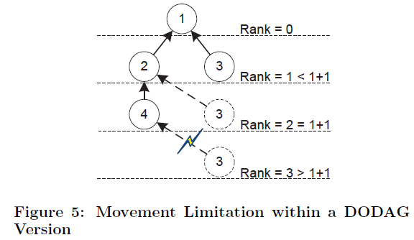
Avoidance Mechanisms
RPL node does not process DIO messages from nodes deeper (higher Rank) than itself.
RPL specification suggests that a node must never advertise within a DODAG Version a Rank higher than RankLowest + RankMaxInc.
RankLowest is the lowest Rank the node has advertised within a DODAG Version.
RankMaxInc is a predefined constant received via a DIO.

Slide 16
Detection Mechanisms
RPL loop detection uses additional information that is transported in the data packets.
It places a RPL Packet Information in the IPv6 option field which is updated and examined on each hop.
There are five control fields within the RPL Packet Information.
The packet is sent in a upward or downward direction.
Reports if a Rank mismatch has been detected.
Report a error field by a child node.
The Rank of the sender.
The RPL Instance ID.

Slide 17
DOWNWARD ROUTING
The support of downward routing is another important feature of RPL.
The RPL specification defines two modes of operation for supporting P2MP.
Non-storing mode
Storing mode
In this section:
DAO Message Structure
Non-Storing Mode
Storing Mode

Slide 18
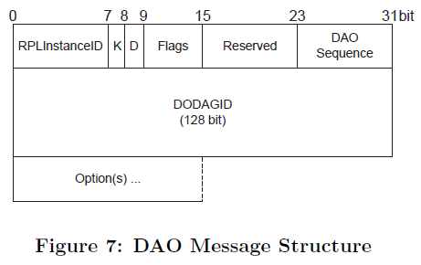
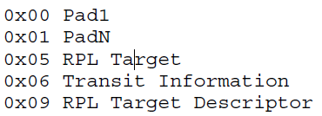
DAO Message Structure
DAO Option

Slide 19
Non-Storing Mode
In the non-storing mode each node generates a DAO message and sends it to the DODAG root.
The RPL specification suggests that the delay between two DAO sending operations may be inversely proportional to the Rank.
The resulting DAO message is sent directly to the DODAG root along the default route created during parent selection.
The DODAG root can piece together a Downward route to a node by using DAO parent sets from each node in the route.

Slide 20
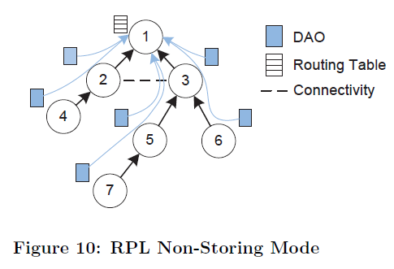
Non-Storing Mode(Cont.)

Slide 21
Storing Mode
Similar to the non-storing mode, the storing mode also requires the generation of DAO messages.
However, a DAO is no longer propagated to the DODAG root.
Instead, it is sent as unicast to all parent nodes which maintain additional downward routing tables.

Slide 22
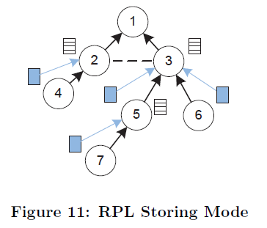
Storing Mode(Cont.)

Slide 23
CONCLUSION
LLNs and WSNs are rapidly emerging as a new type of distributed systems.
RPL was specified and developed in order to overcome these requirements about high delivery ratio and energy efficient at same time.
RPL also allows optimization of the network for different application scenarios and deployments.

Slide 24
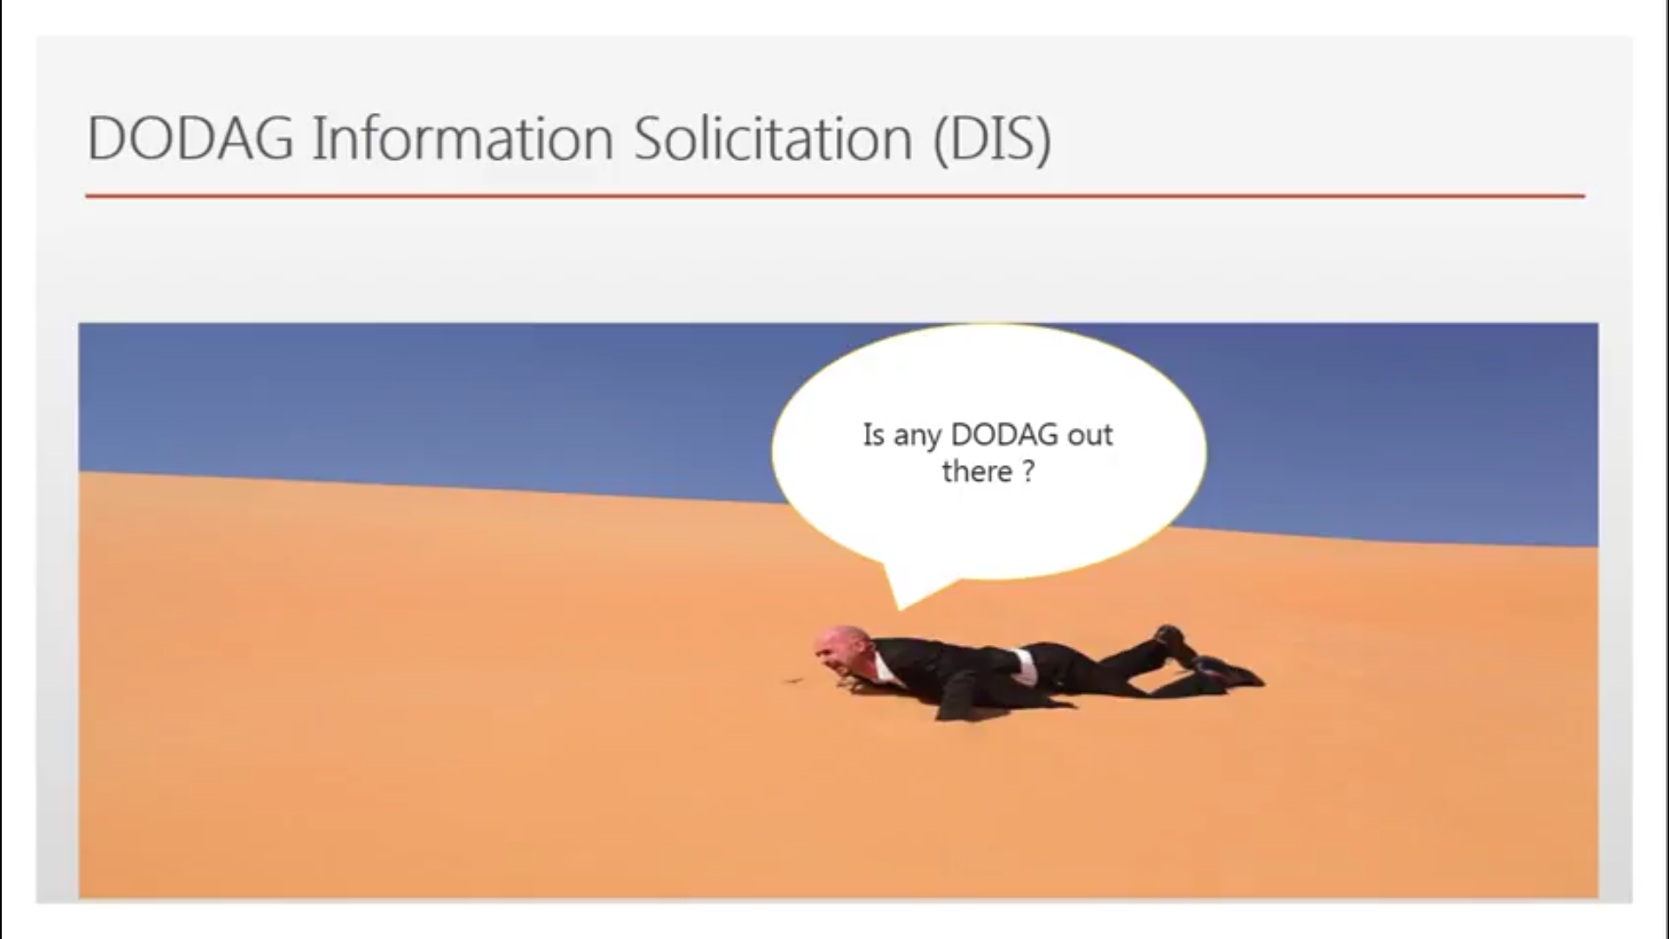

Slide 25
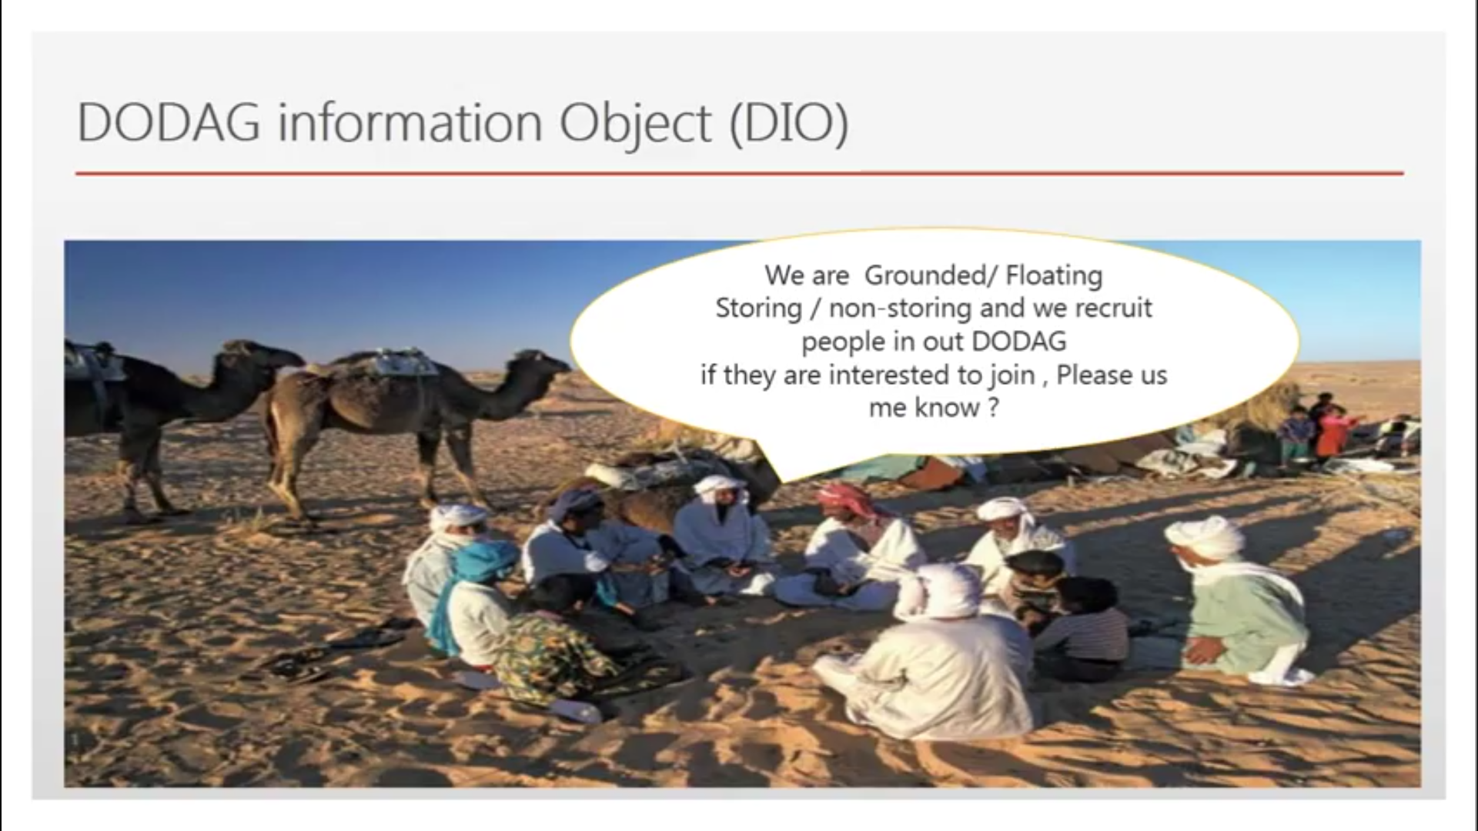

Slide 26
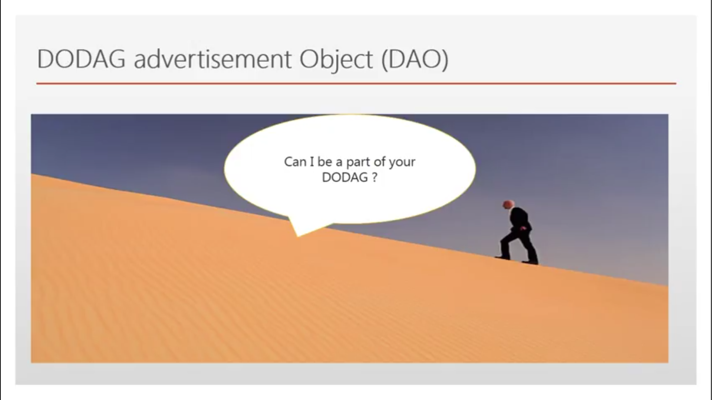

Slide 27
